Slide 1
Employee Data Analysis using Excel
Alesha Fathima Samiulla
STUDENT NAME: Alesha Fathima Samiulla
REGISTER NO: 122201969
DEPARTMENT: lll year B.Com (CS)
COLLEGE: Chevalier T. Thomas Elizabeth College for Women

Slide 2


Slide 3


AGENDA
Problem Statement
Project Overview
End Users
Our Solution and Proposition
Dataset Description
Modelling Approach
Results and Discussion
Conclusion
3/21/2024 Annual Review

Slide 4

PROBLEM STATEMENT
High employee turnover is hurting our organization's productivity, morale, and finances, with a 25% increase over the past year.
Key reasons include lack of career growth, insufficient compensation, and poor work-life balance.
Our goal is to reduce turnover by 15% within the next 12 months.

Slide 5

PROJECT OVERVIEW
The project aims to reduce the organization's employee turnover rate, which has risen by 25% over the past year, impacting productivity, morale, and costs. We will identify root causes, such as career growth, compensation, and work-life balance, and implement strategies to achieve a 15% reduction in turnover within the next 12 months.

Slide 6

WHO ARE THE END USERS?
The end users of this project are the organization’s employees and managers.
Employees will benefit from improved career development opportunities, better compensation, and enhanced work-life balance, while managers will experience reduced turnover, improved team stability, and higher productivity.
Additionally, the human resources team will utilize the strategies and tools developed to monitor and maintain employee satisfaction and retention.

Slide 7

OUR SOLUTION AND ITS VALUE PROPOSITION
Our solution is a comprehensive employee retention strategy that focuses on improving career development opportunities, offering competitive compensation, and promoting better work-life balance. This approach aims to reduce turnover by enhancing employee satisfaction and engagement, leading to lower recruitment and training costs, improved productivity, and a stronger workplace culture. The value proposition is a more stable, motivated workforce that contributes to long-term organizational success and competitiveness.

Slide 8
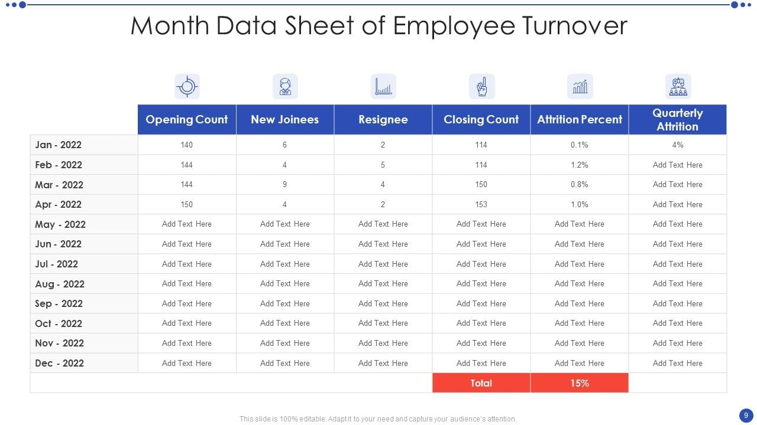
Dataset Description

Slide 9

THE "WOW" IN OUR SOLUTION
Our solution goes beyond traditional retention strategies by using data-driven insights to create a personalized employee experience. By leveraging predictive analytics, we can identify at-risk employees and proactively address their concerns with tailored career development plans, personalized incentives, and customized work-life balance initiatives
3/21/2024 Annual Review
9

Slide 10
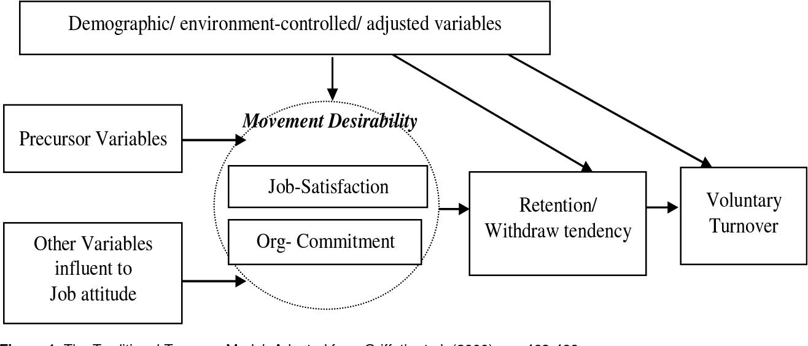
MODELLING
We will employ predictive modeling techniques, including logistic regression and machine learning algorithms like decision trees and random forests, to analyze employee data and identify factors influencing turnover. This approach will enable us to forecast which employees are at risk of leaving and understand the underlying causes, allowing for targeted interventions such as personalized development plans and tailored incentives to reduce turnover and improve overall employee satisfaction.
10

Slide 11
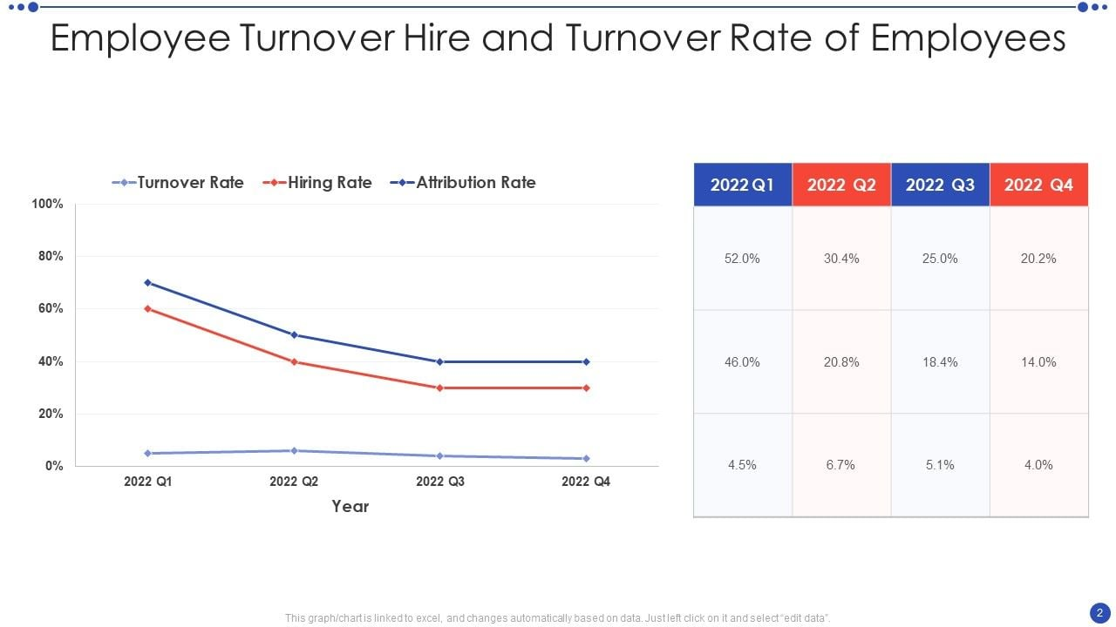
RESULTS
The predictive modeling will yield a detailed analysis of turnover risk factors, enabling us to identify high-risk employees and the key drivers behind their potential departure. By implementing targeted retention strategies based on these insights, we anticipate a 15% reduction in turnover within the next 12 months, improved employee satisfaction, and increased organizational stability
11

Slide 12
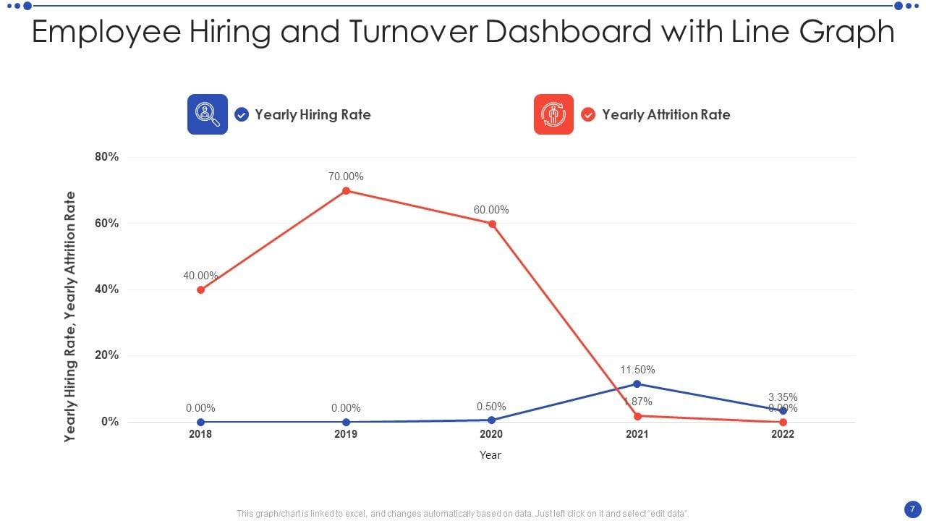
conclusion
By leveraging predictive modeling to identify key turnover factors and implementing targeted retention strategies, we aim to reduce employee turnover by 15% within a year. This approach will enhance employee satisfaction, lower recruitment and training costs, and improve overall productivity and morale, leading to a more stable and successful organization.

